Slide 1

Public Transport
Spatial Analysis with R
Chia-Jung (Robert) Yeh
葉家榮
2025.10

Slide 2

Download the slides and code:
https://unisydneyedu-my.sharepoint.com/:f:/g/personal/cyeh0303_uni_sydney_edu_au/Ego-1SfJUWJEkHpnsdFALFMBCIDmejk5DIdZJzZ6RxYOsA?e=kxSH5l

Slide 3








What is Big Data
Data
Tools/Skills/Theories
Information
Knowledge/Experience
Wisdom
(Policy Implications, Decision Making)

Slide 4
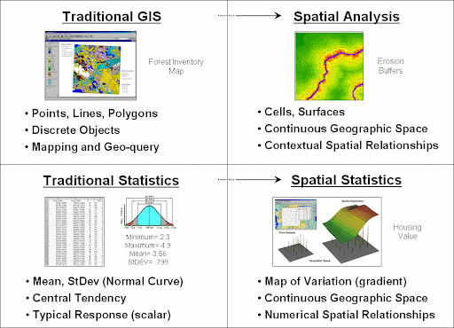
What is Spatial Data
Spatial data describes the shape and location of features and boundaries such as natural features, buildings, survey marks, land parcels, street addresses and local government and administrative boundary areas.

Slide 5
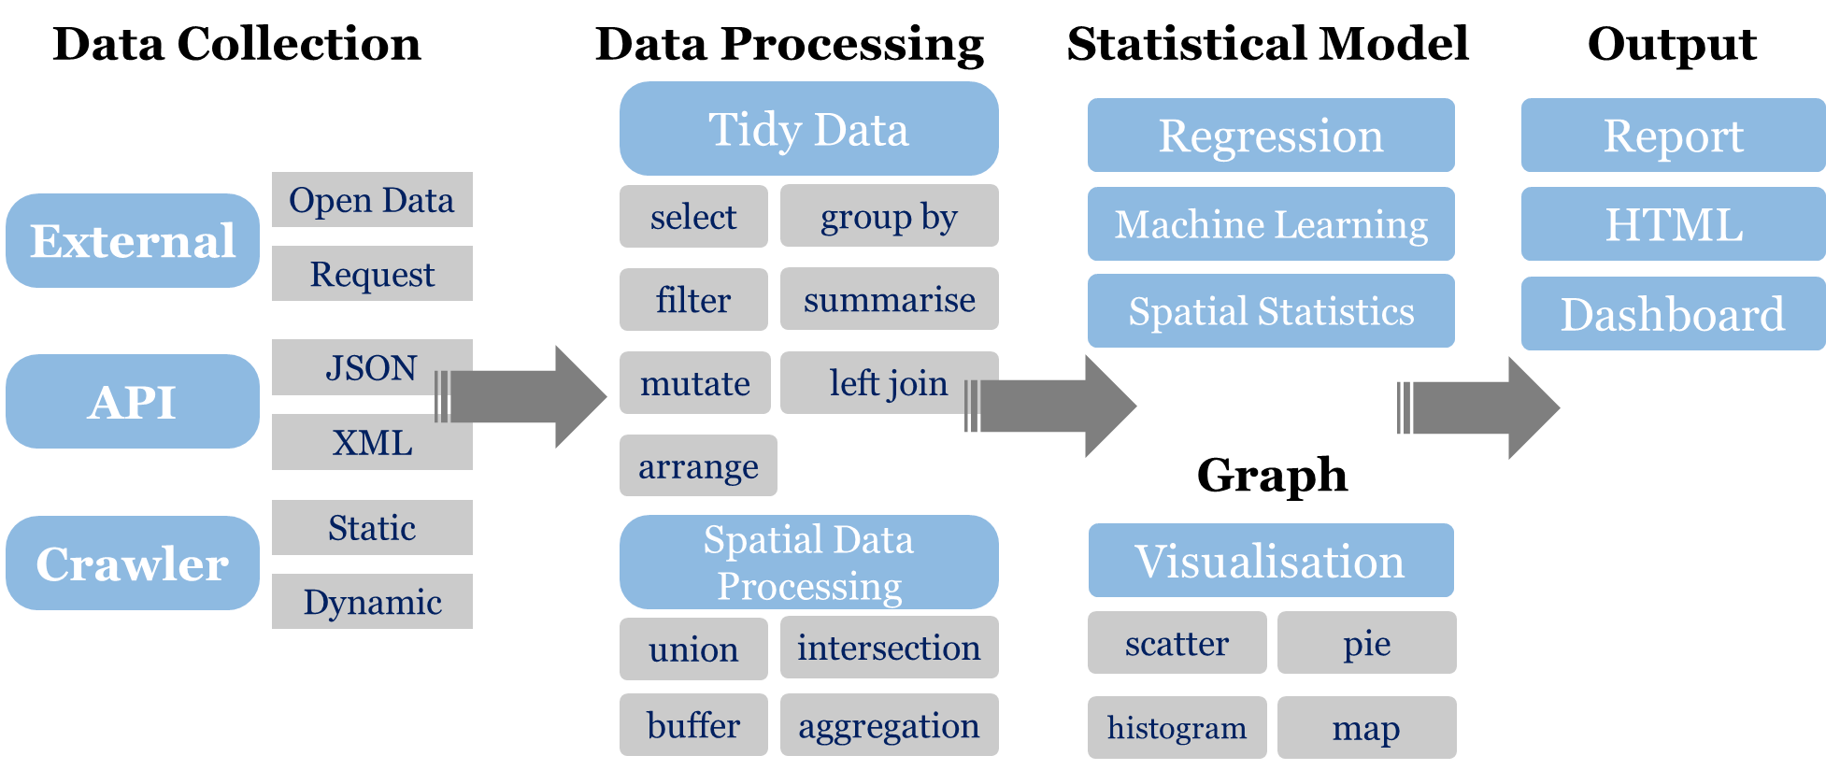
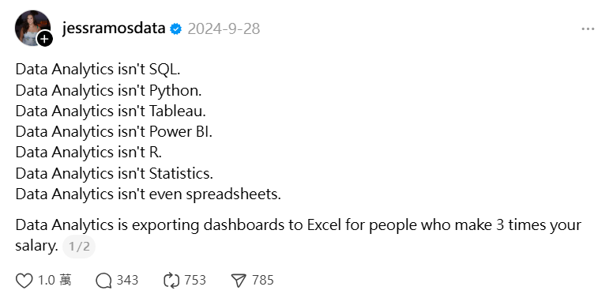

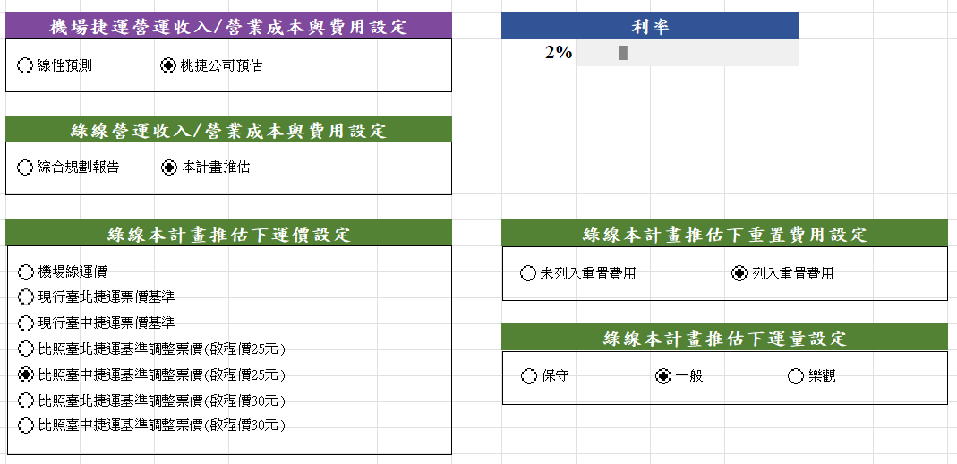
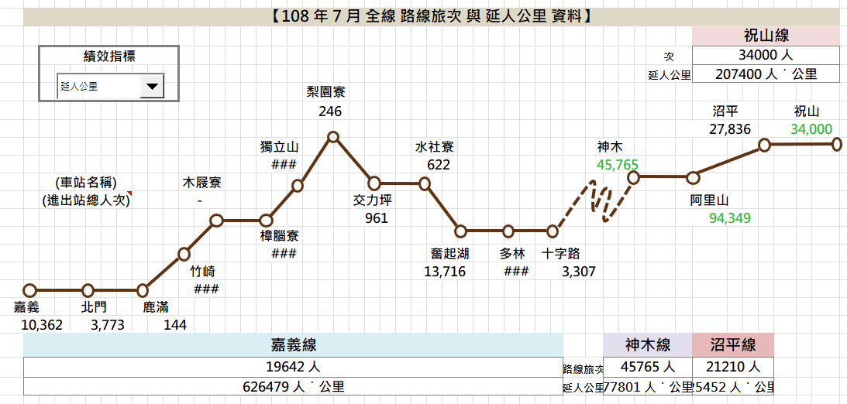
What is Data Analysis
If you are a data analyst…
If you are a supervisor…
Railway Bureau Operational KPI Dashboard (2019)
Taoyuan MRT
Financial Model Dashboard
(2025)

Slide 6
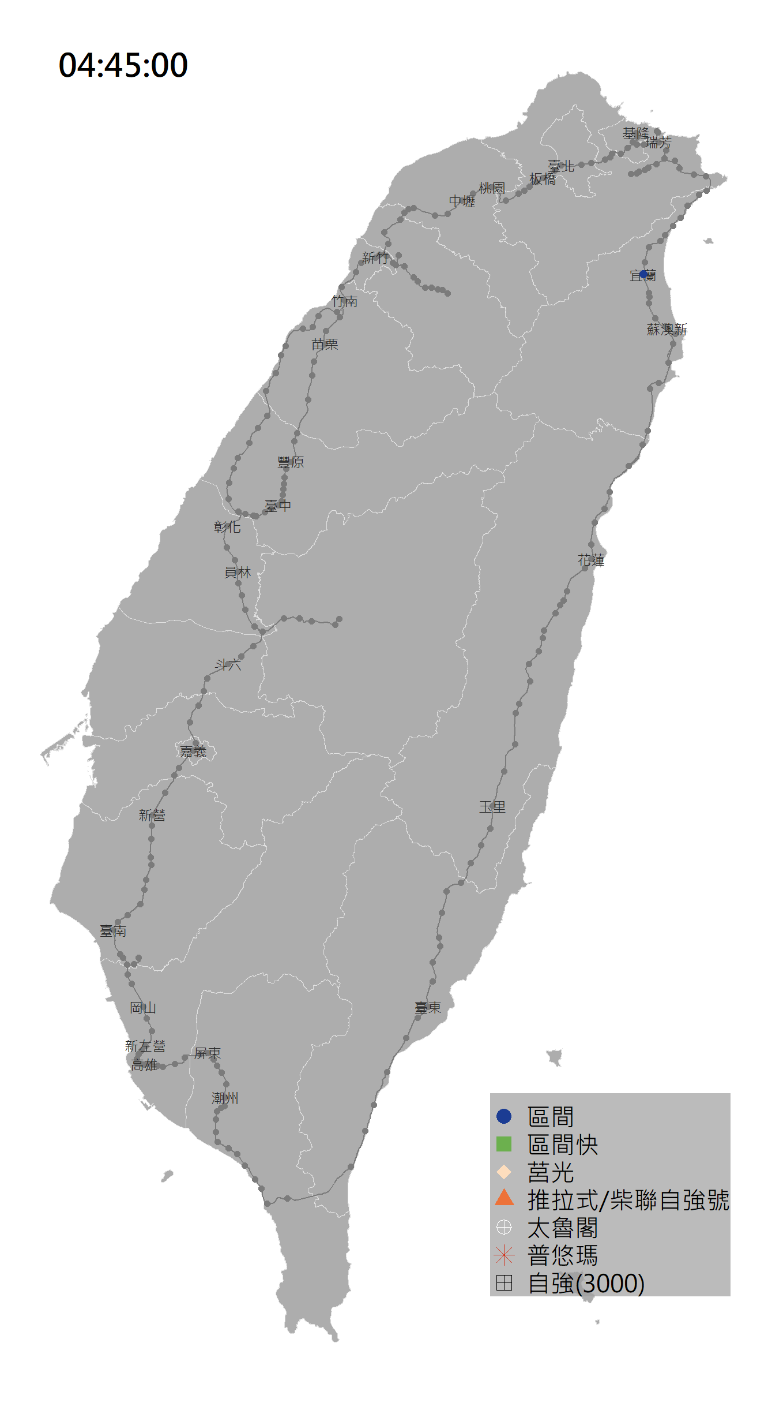
Application of Spatial Analysis

Slide 7





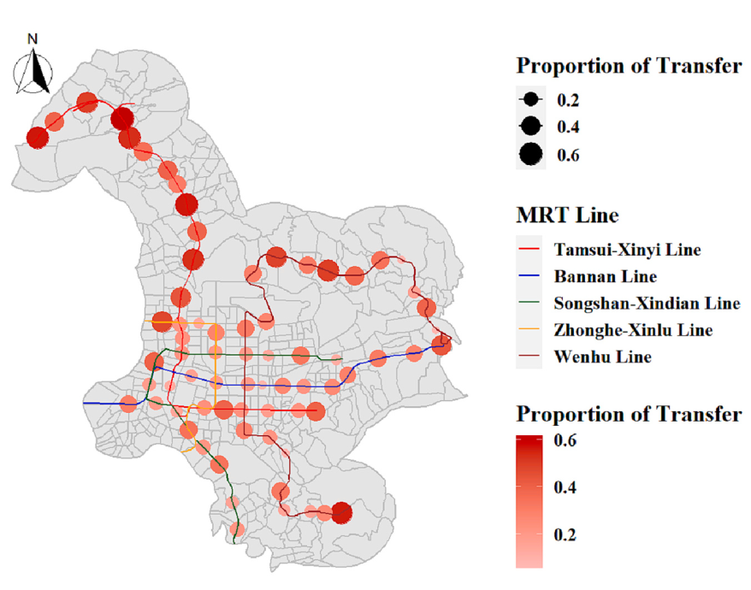
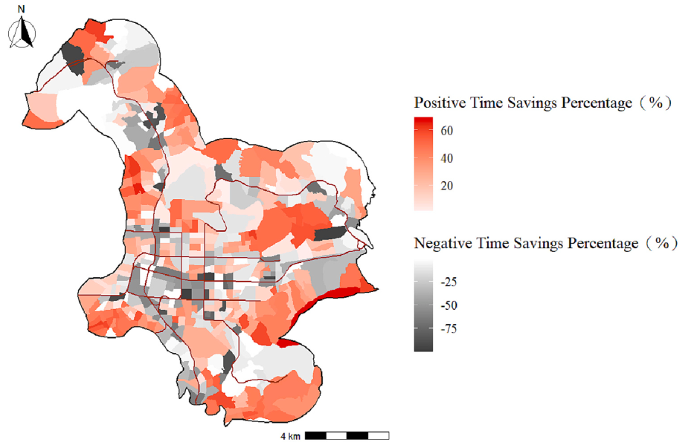
Shared-bike Analysis
Yen, B. T., Mulley, C., & Yeh, C. J. (2023). How public shared bike can assist first and last mile accessibility: A case study of the MRT system in Taipei City, Taiwan. Journal of Transport Geography, 108, 103569.
YouBike
First-mile-and-last-mile
Enhance public transport accessibility
Transfer between modes
Walking
Transfer

Slide 8
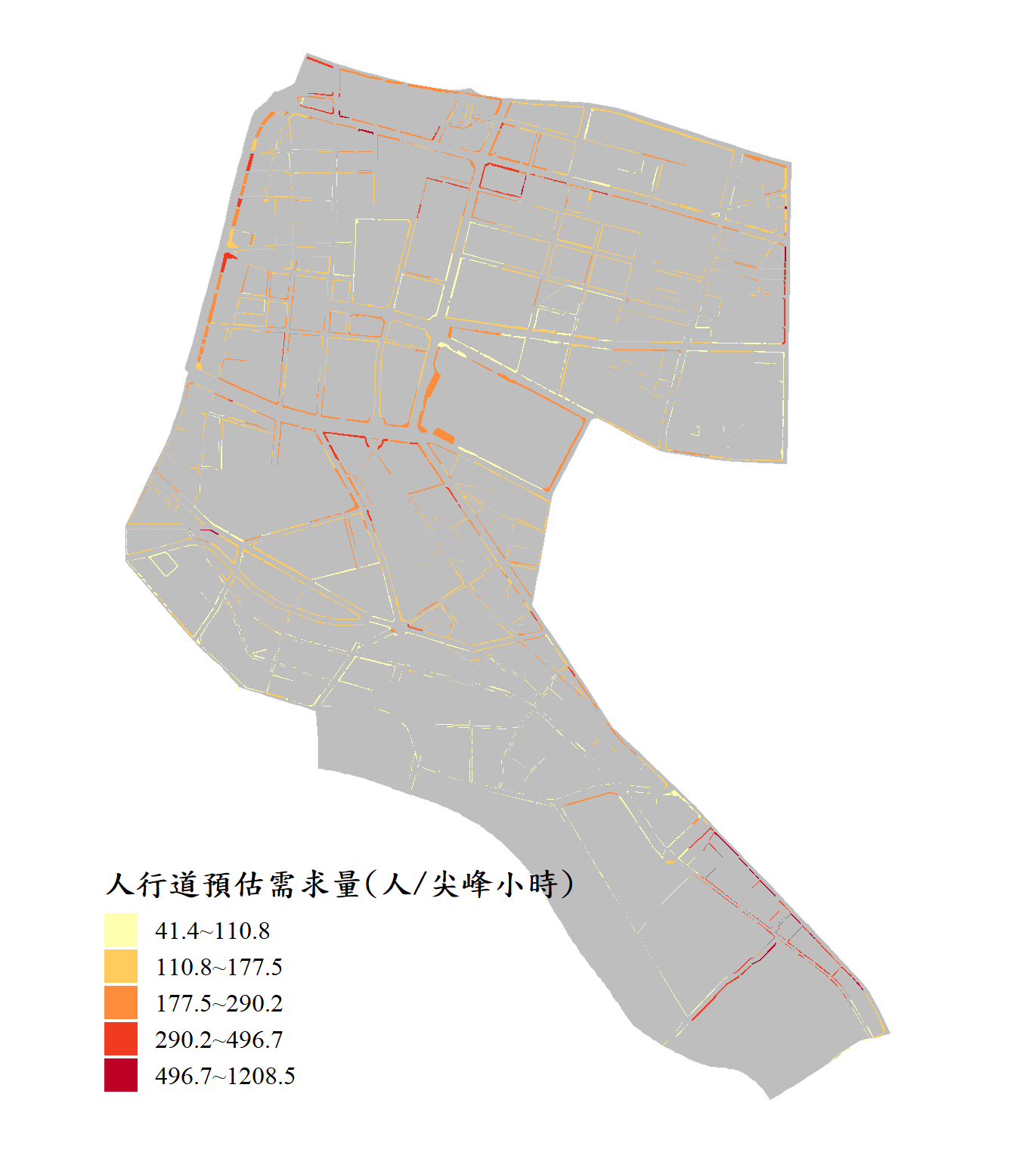
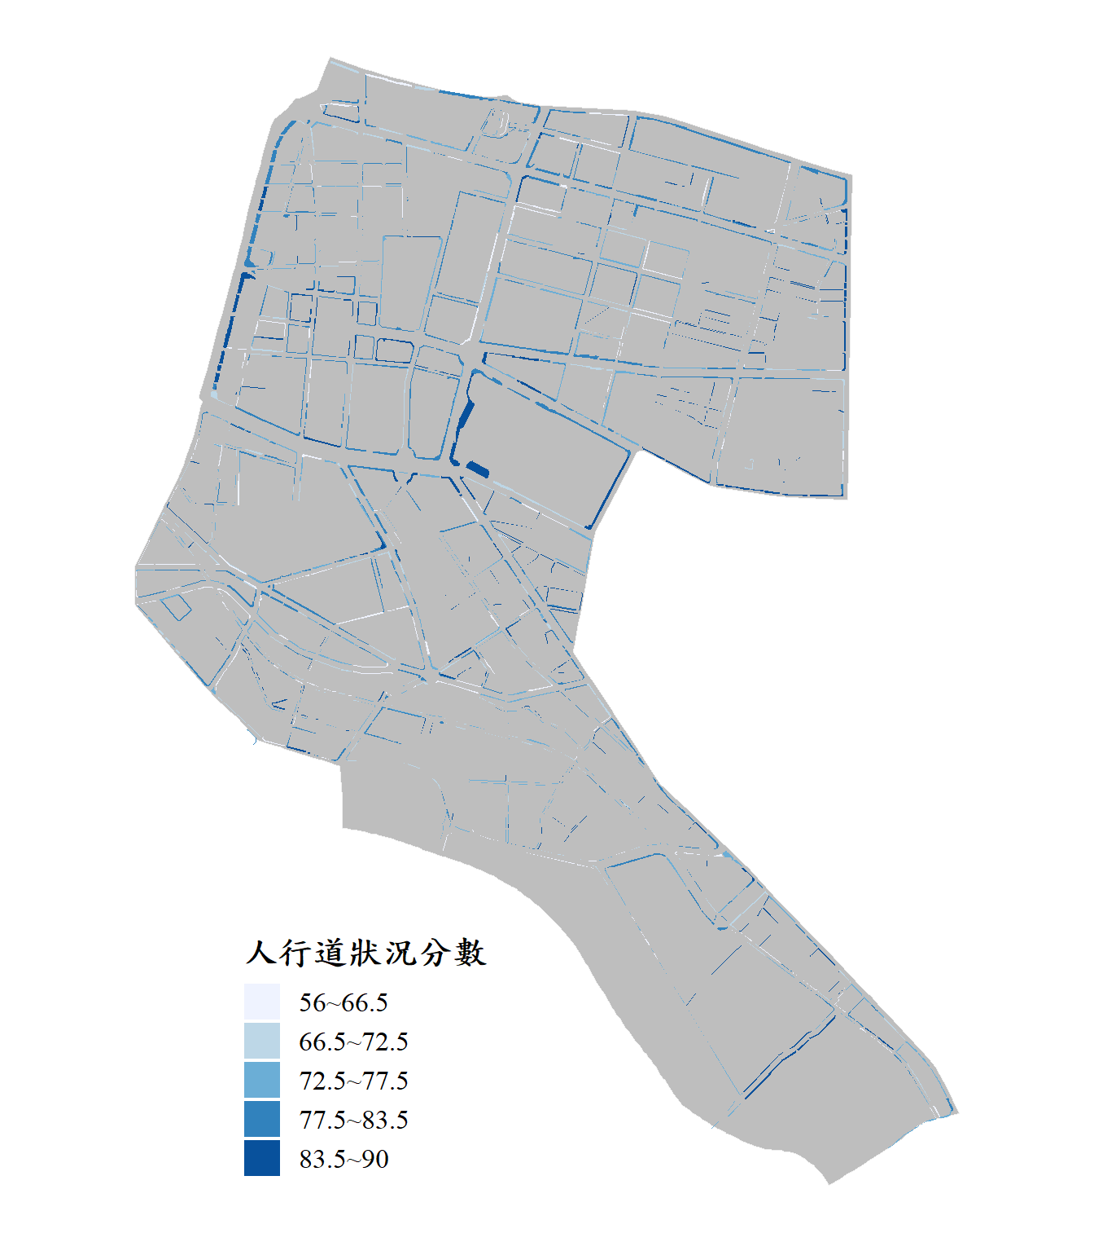
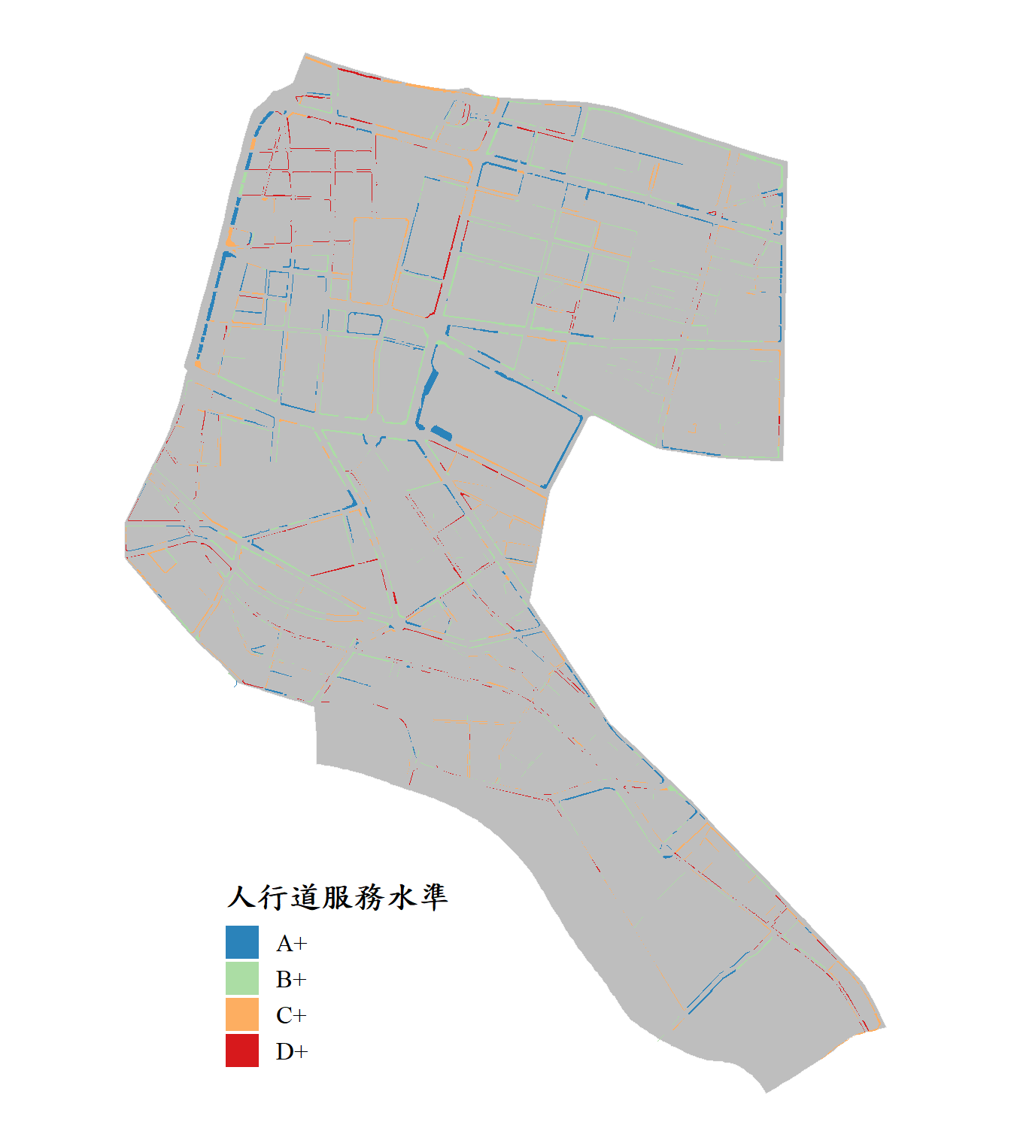
Pedestrian Scoring
https://chiajung-yeh.github.io/R-Code-Sharing/Sidewalk_Score/中正區人行道地圖.html
Example: 中正 District, Taipei

Slide 9
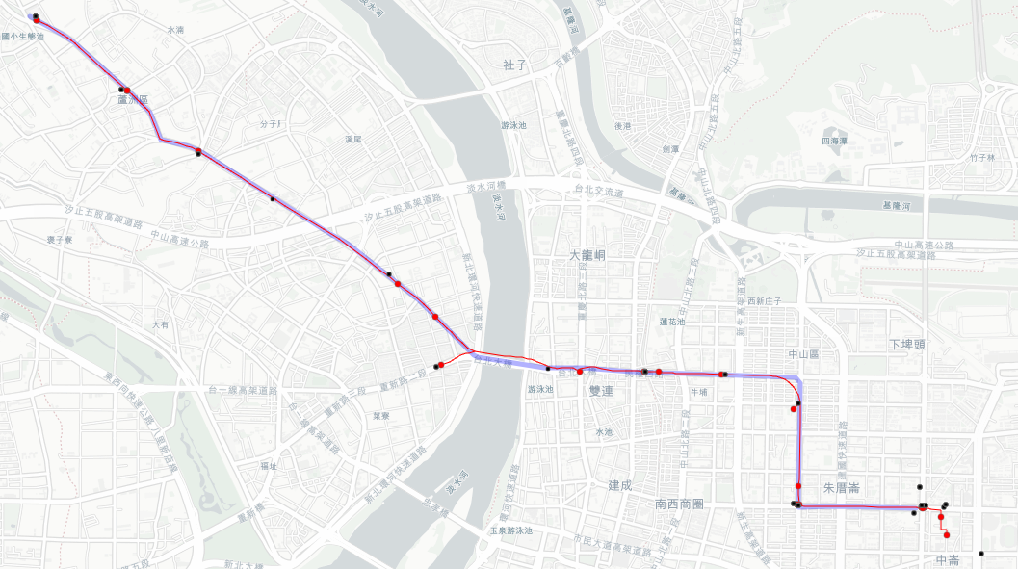
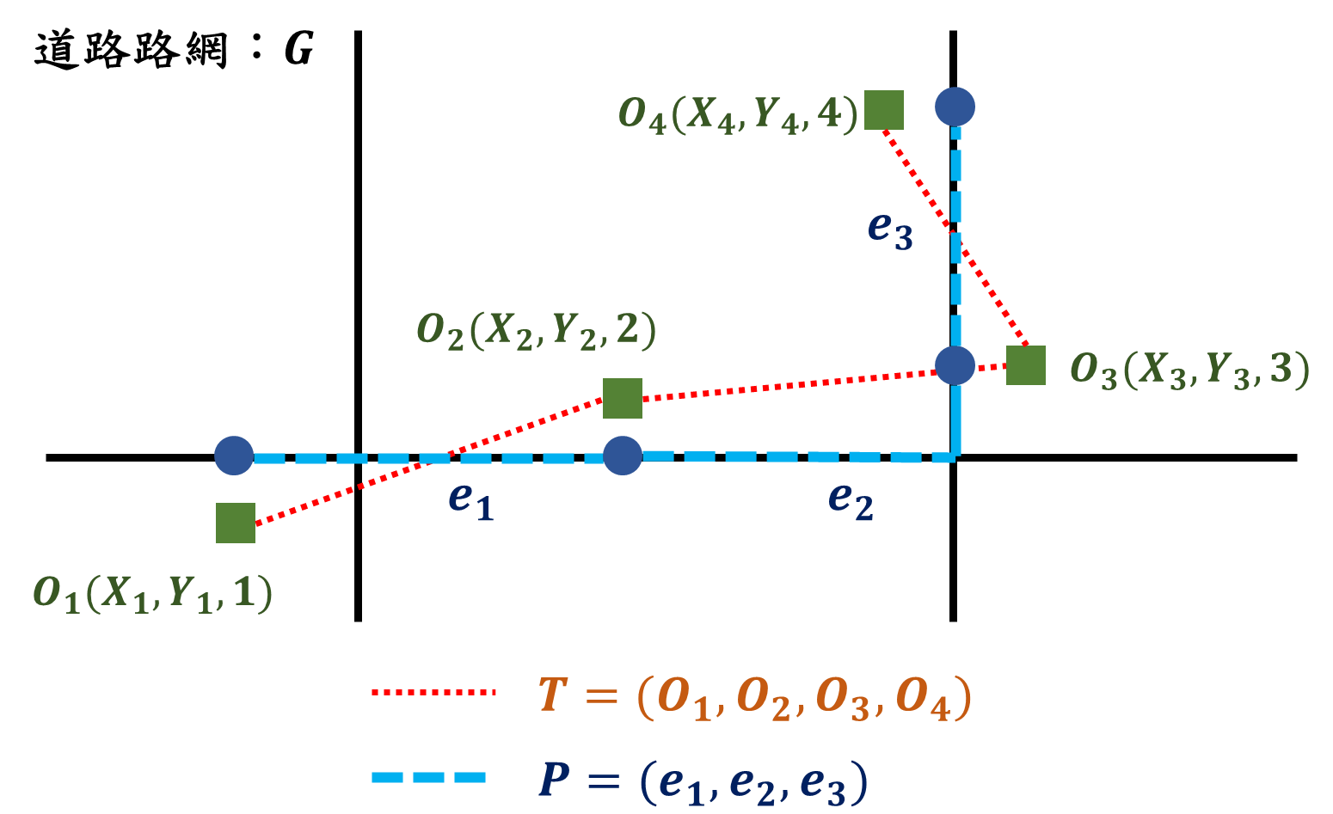
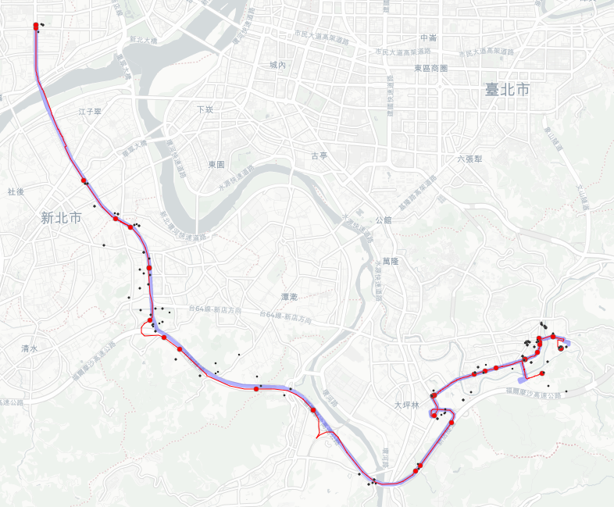
Cellular Data Analysis
葉家榮、邱裕鈞（2025）。建構以信令旅運曝光量與事故風險地圖為基礎之駕駛風險評估。運輸學刊，37(2)，97-135。
Map Matching
Match cellular data to network
Mode Detection
Identify the mode used based on spatial features.

Slide 10
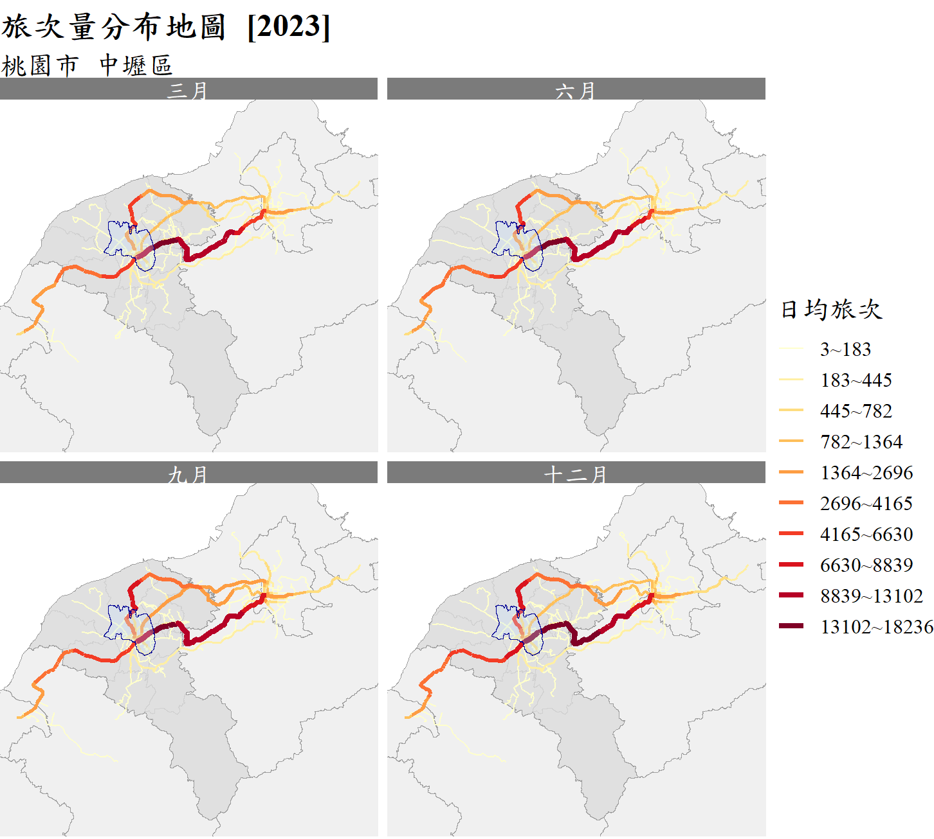
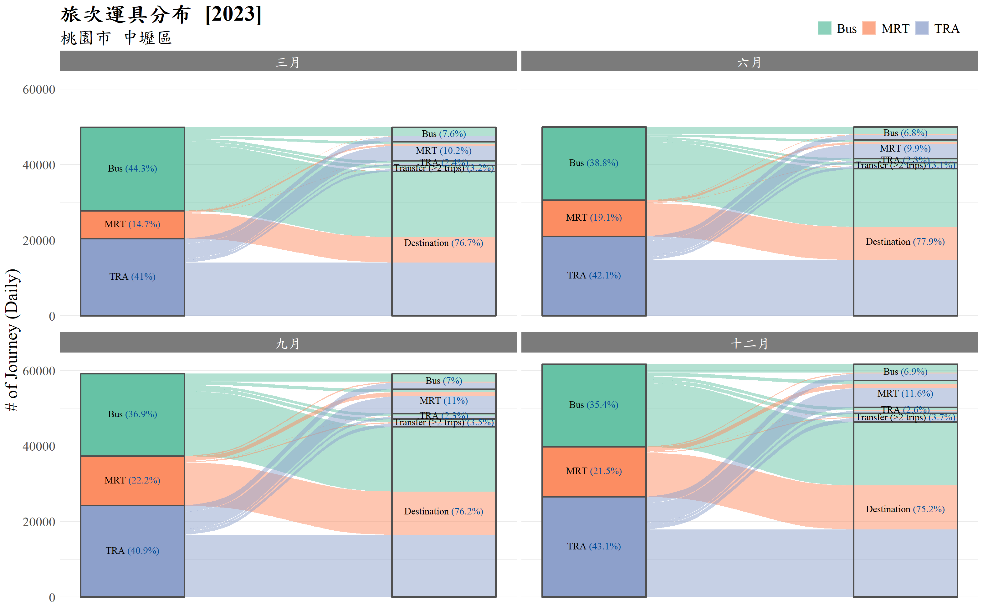
TPASS Analysis

Slide 11
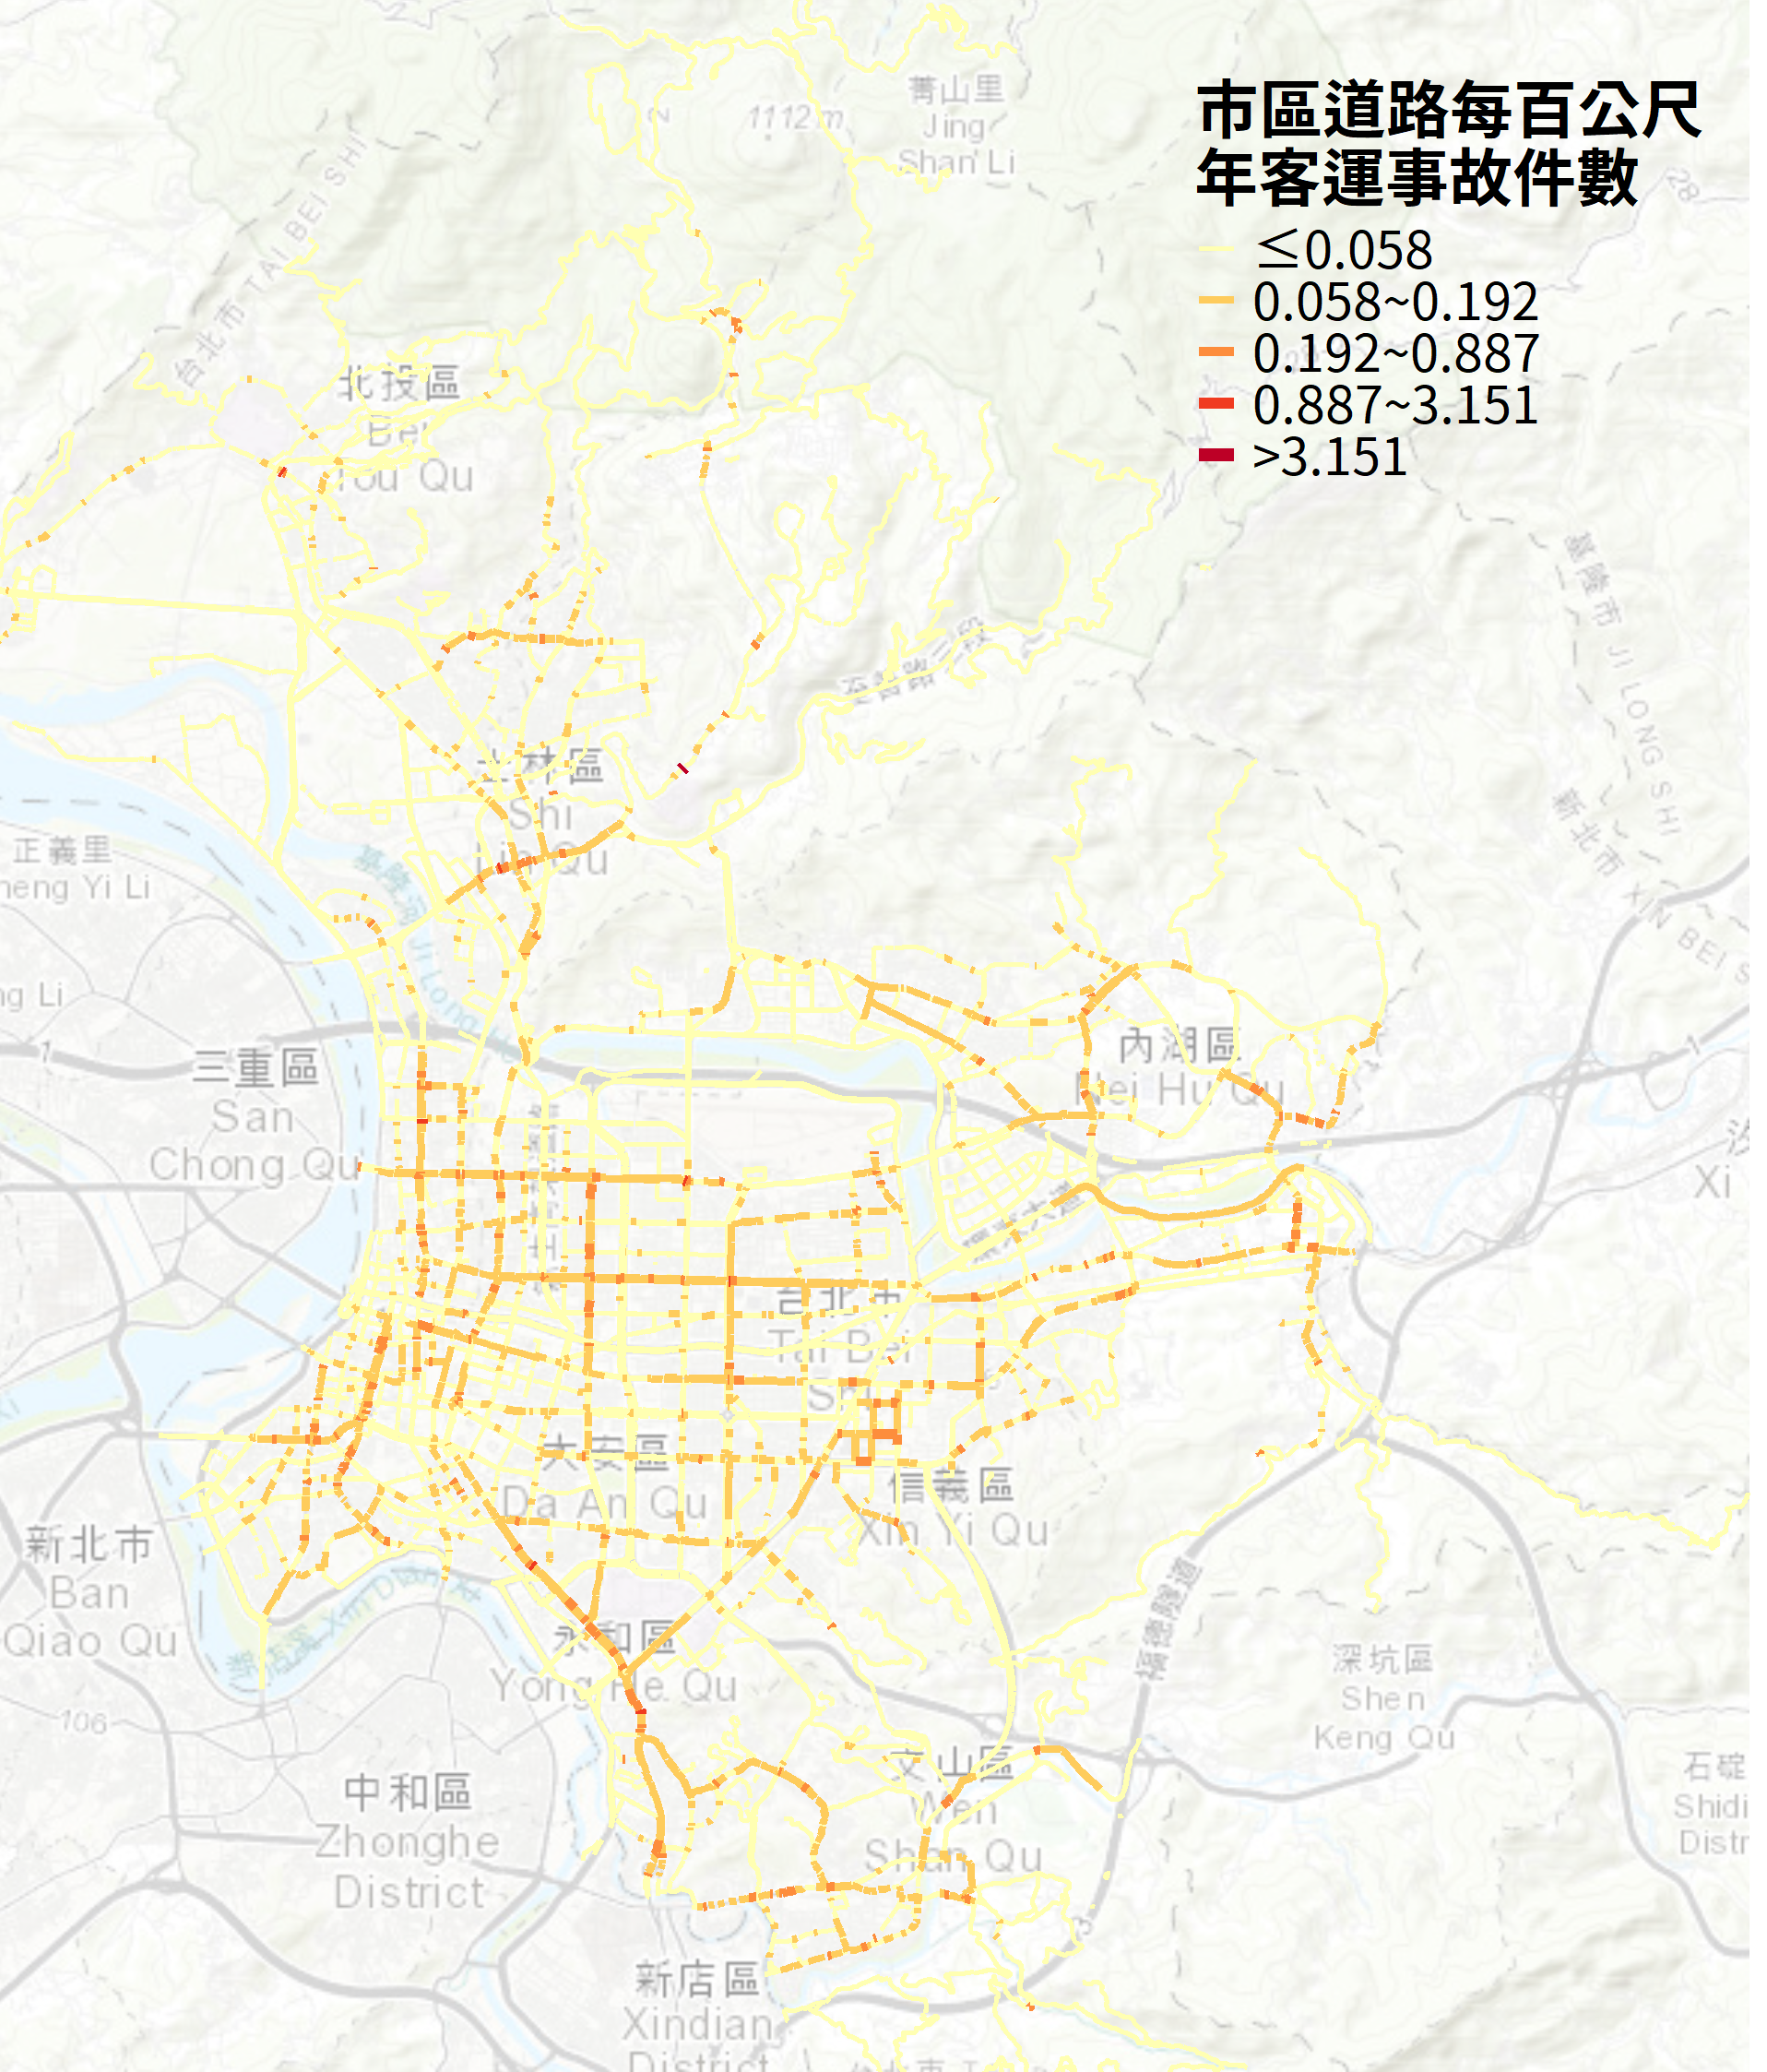
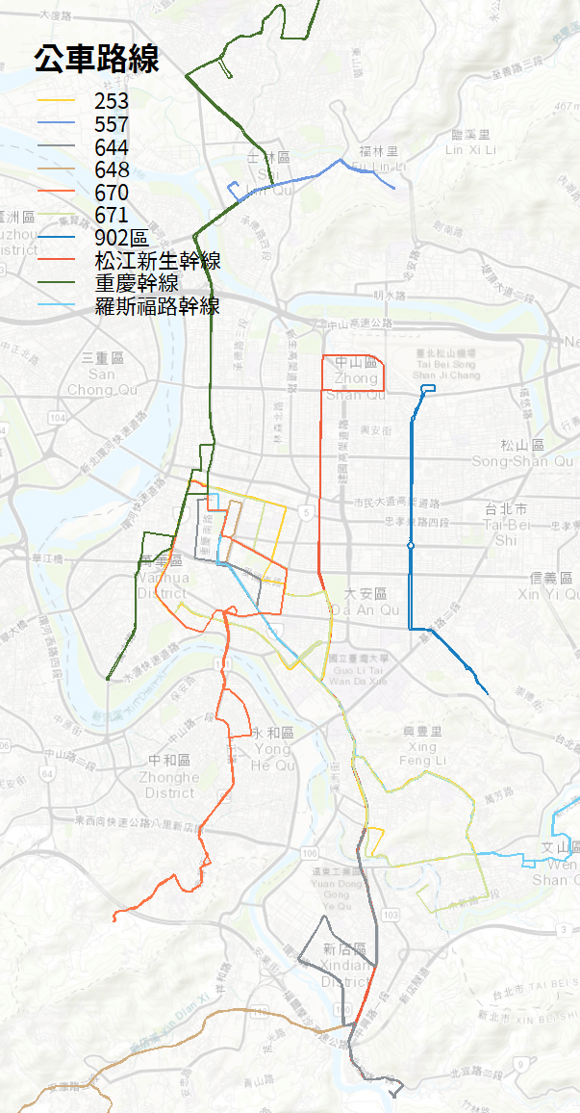
Bus Crash Analysis

Slide 12
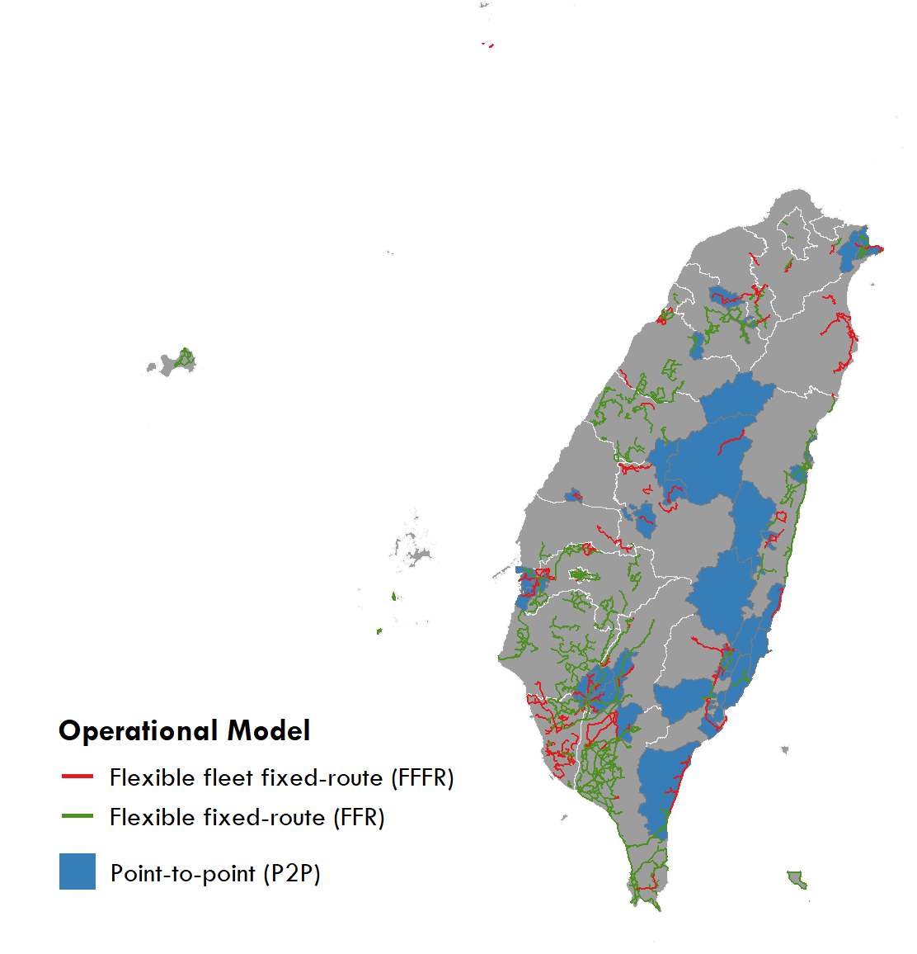
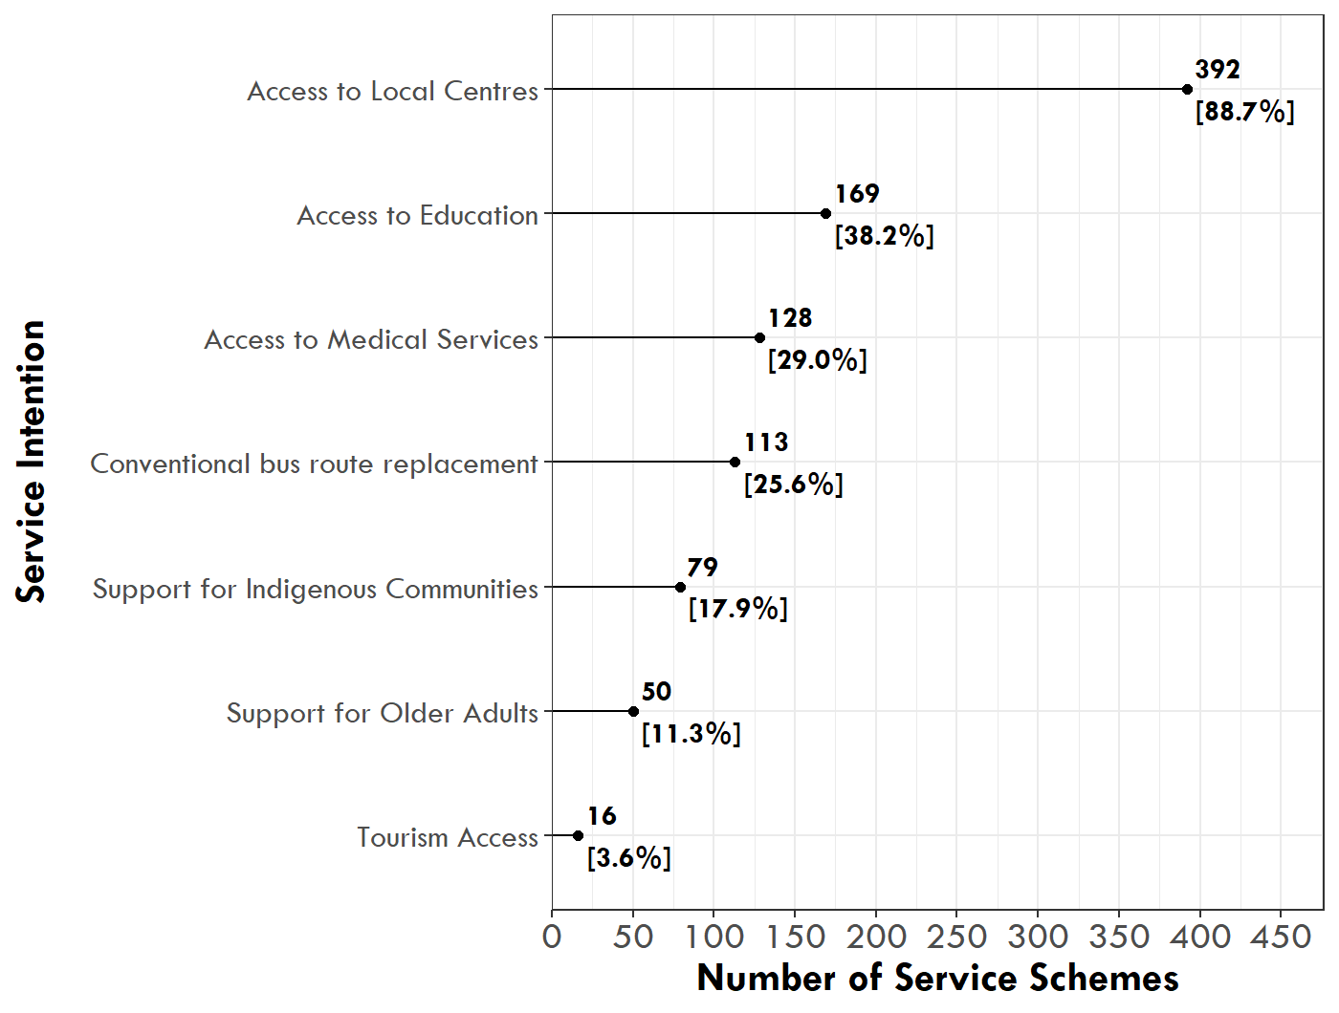
Demand Responsive Transport
需求反應式公共運輸服務(DRTS)營運成本、補貼制度及收費制度之研究(2025)
Yen, B. T., Mulley, C., & Yeh, C. J. (2023). Performance evaluation for demand responsive transport services: A two-stage bootstrap-DEA and ordinary least square approach. Research in Transportation Business & Management, 46, 100869.

Slide 13
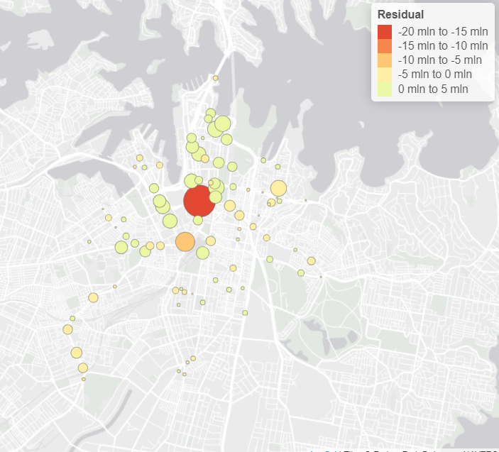
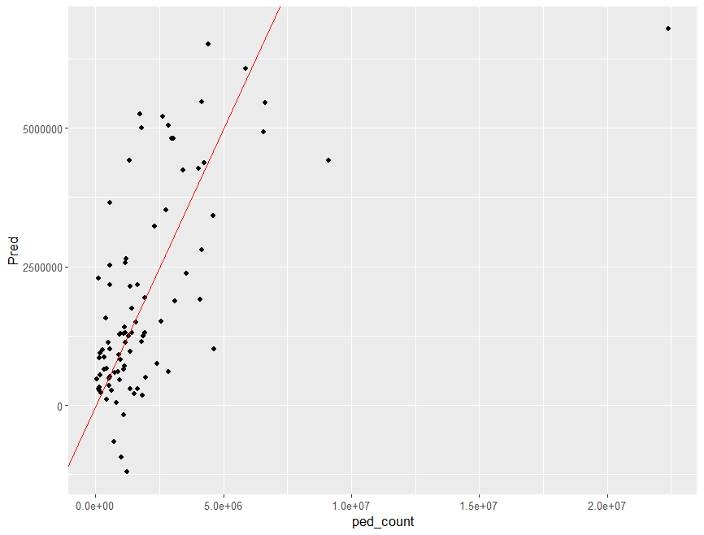
Road User Activity Analysis
WHY: The pedestrian counters are only limited to some areas with lower coverage.
HOW: Develop a model to apply the pedestrian user data to infer the demand of real pedestrian on the network.

Slide 14
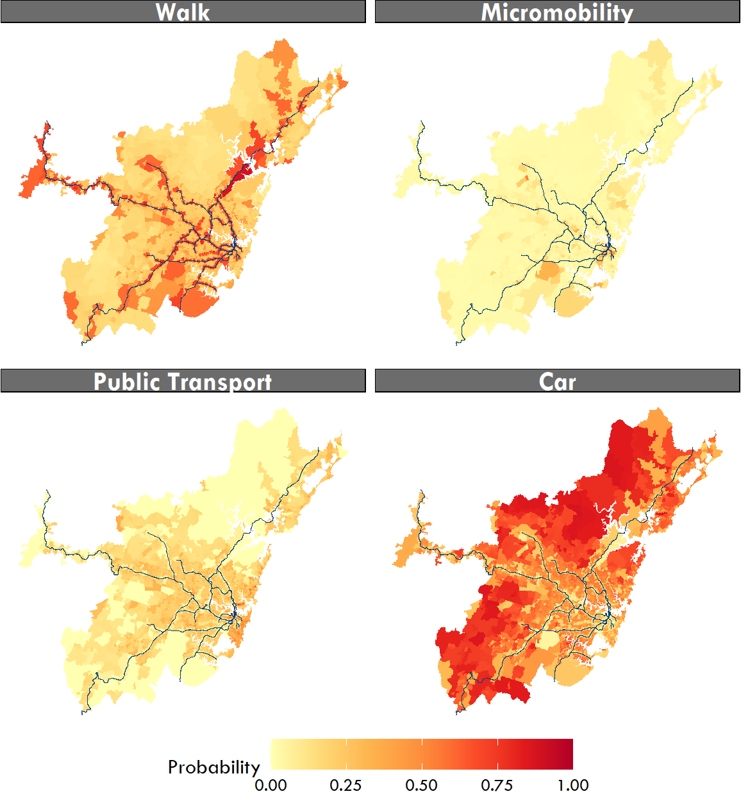

Micromobility Preference
Survey
Understand the use/travel pattern of micromobility for the last mile of train stations.
Choice Model
Identify the key factors of using micromobility.
Predict the probability of using micromobility with given policy and infrastructure.
Derive policy implications from model result.

Slide 15
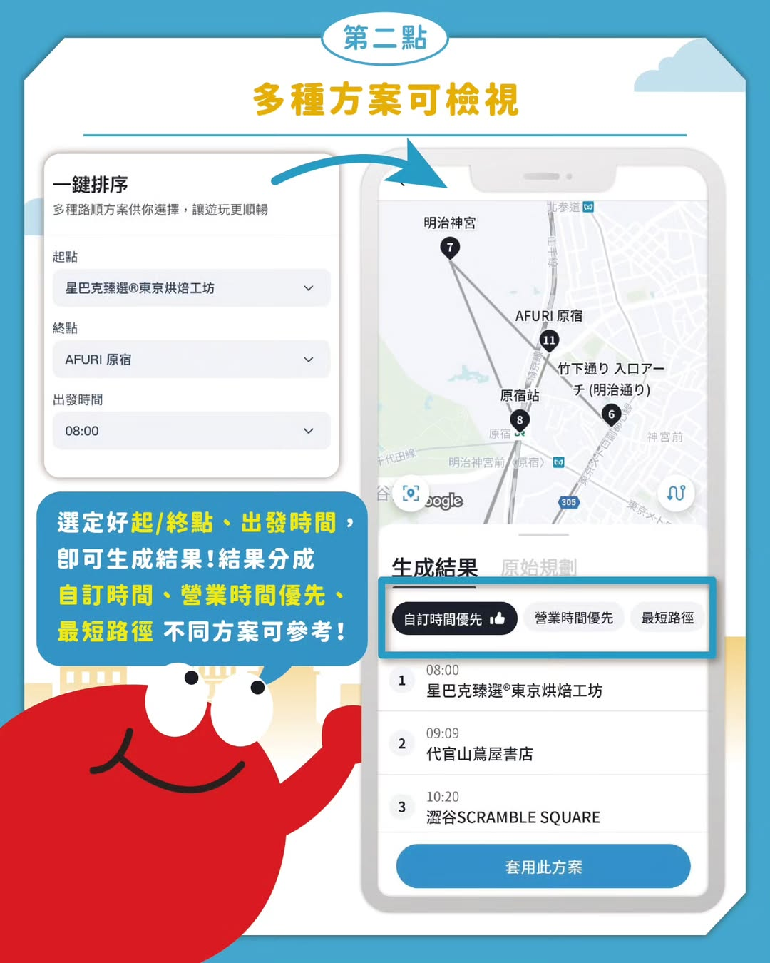





Travel Itinerary Application

Slide 16
Ways to Learn Spatial Analysis

Slide 17

Learning Materials
Transport Data Analysis
R Basic Syntax
Data tidy
Data Visualisation
https://bookdown.org/chiajungyeh/Transport-Analysis-R/
https://chiajung-yeh.github.io/R-Code-Sharing/R_Preliminary/R_Preliminary.html
Spatial Analysis with R
Covered all the contents in this course
https://chiajung-yeh.github.io/Spatial-Analysis/
https://www.books.com.tw/products/0010979785

Slide 18


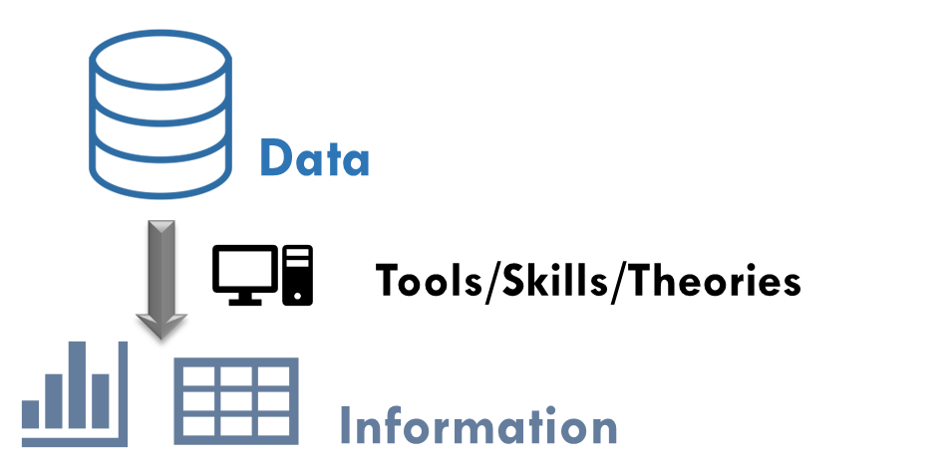
AI Assistance
AI is very clever at writing code (programming language).
How to learn coding efficiently?
Want to be an expert user: read textbooks, practise more
Want to apply code easily: learn from AI, practise from real-world cases
Suggestions:
Innovative ideas
Basic coding knowledge
AI use
Concept/
Idea
Coding/
Prototype

